Slide 1






Web Map Development Prairieview Discovery Day
Mr. Noah
Product Engineer - ArcGIS Maps SDK for JavaScript
May 19, 2023
@noashx
nsager@esri.com

Slide 2
About me
Notes:
Who am I?

Slide 3






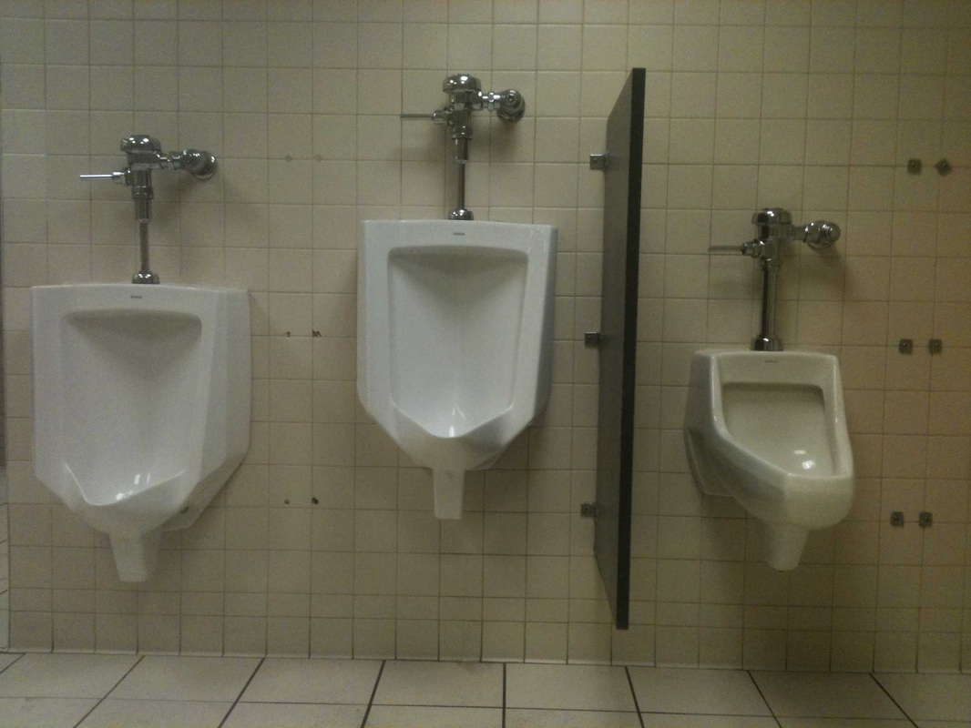

Notes:
A little about me:
First programming experience was on a TI-81 in high school. Made a few games and one “virus”.
Beautiful son
Beautiful daughter
Patriots fan since they drafted drew bledsoe in 1993
Studied squirrel foraging and anti-predator behavior in undergrad
Took a GIS approach to public restroom access in grad school
Before I came to esri they used my picture on promotional material, then after I grew a beard they hired me full time
And of course, I love working with computers

Slide 4
About you
Notes:
Who am I?

Slide 5

About web map development
Notes:
Who am I?

Slide 6

What is…
Geography?
Notes:
Before we jump into the presentation, let’s talk about Geography, GIS, and ArcGIS. We want to figure out as a group where we are at on the following topics.
Ask the group…
What is….
Geography?
GIS?
ArcGIS?

Slide 7
Everything is related.
Things that are closer are more related than things that are farther away.
Notes:
Simple, clear, definition. Tobler’s first law of Geography.
https://en.wikipedia.org/wiki/Tobler%27s_first_law_of_geography

Slide 8
What is…
Geography?
GIS?
Notes:
Before we jump into the presentation, let’s talk about Geography, GIS, and ArcGIS. We want to figure out as a group where we are at on the following topics.
Ask the group…
What is….
Geography?
GIS?
ArcGIS?

Slide 9
Geographic Information System (GIS) lets us visualize, question, analyze, and interpret data to understand relationships, patterns, and trends. GIS benefits organizations of all sizes and in almost every industry.
Notes:
Dictionary definition

Slide 10
GIS is a tool/science/technology that collects, analyzes, and visualizes spatial relationships on a computer*.
Notes:
Working definition

Slide 11
What is…
Geography?
GIS?
web map development?
Notes:
Before we jump into the presentation, let’s talk about Geography, GIS, and ArcGIS. We want to figure out as a group where we are at on the following topics.
Ask the group…
What is….
Geography?
GIS?
ArcGIS?

Slide 12
Web map development is a
kickbutt great way to solve
geospatial problems in
a creative and totally relevant/unique workflow.
Notes:
If location matters, and programming is cool, then…

Slide 13
So what?

Slide 14
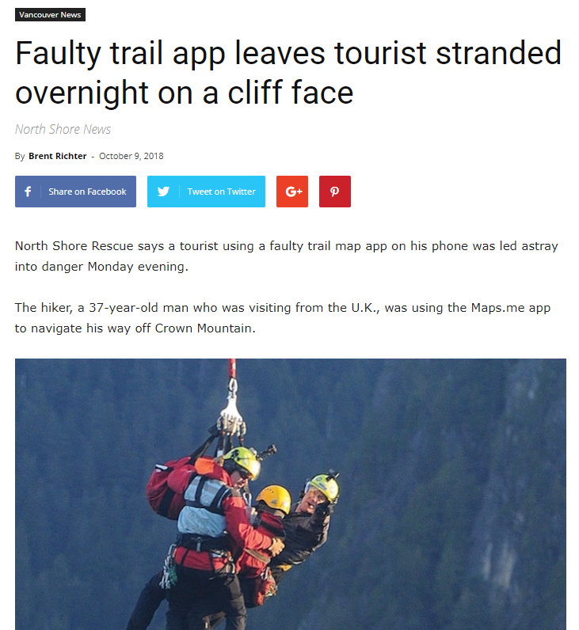
Notes:
https://www.vancouverisawesome.com/2018/10/09/tourist-app-stranded-crown-mountain-north-vancouver/

Slide 15
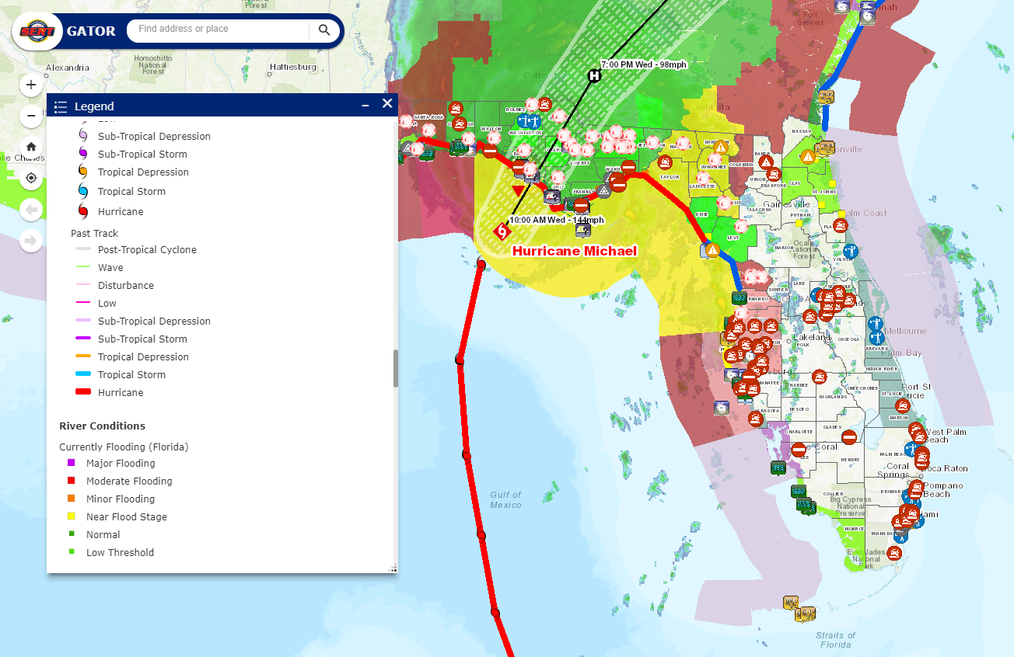
Notes:
https://floridadisaster.maps.arcgis.com/apps/webappviewer/index.html?id=f5628cfc02ca42b4a3853c69d8ff804b

Slide 16
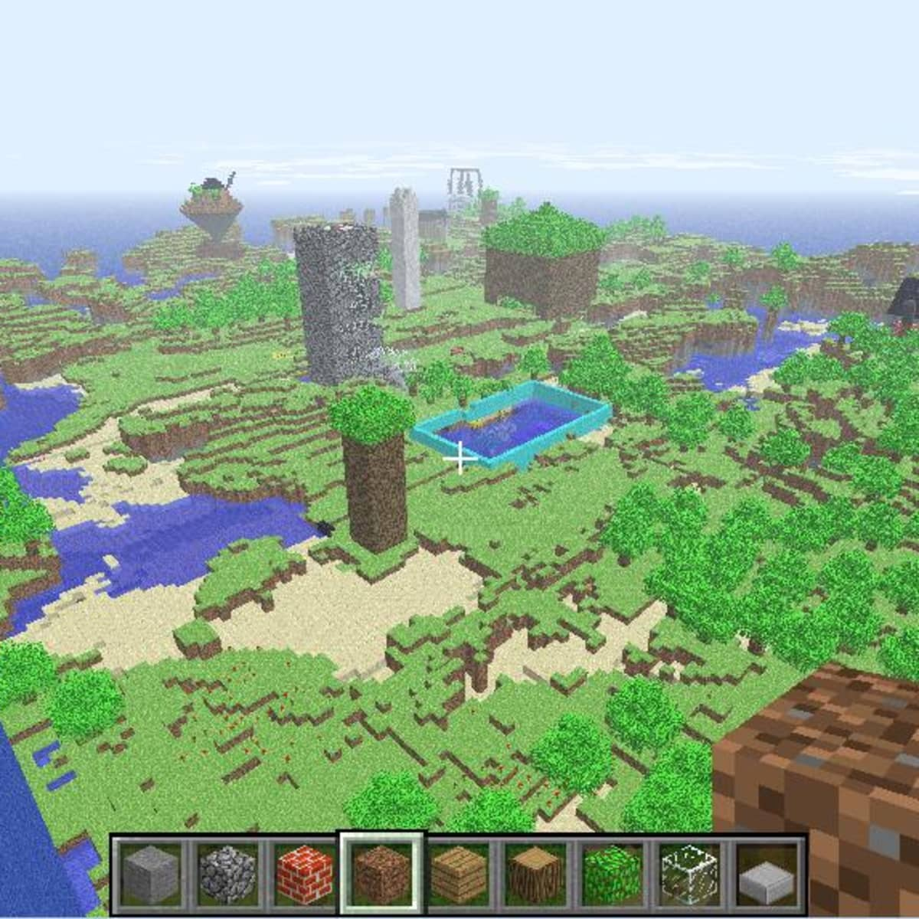
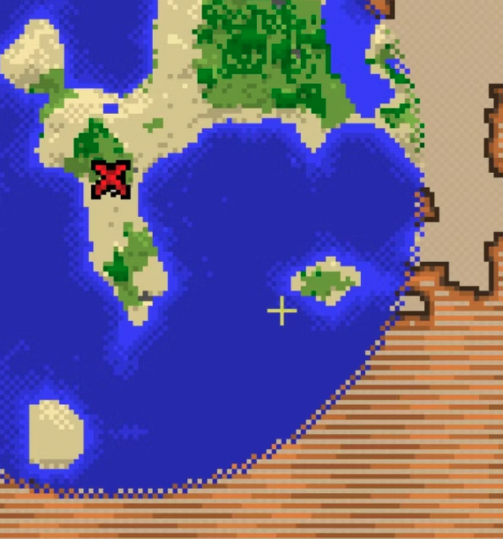
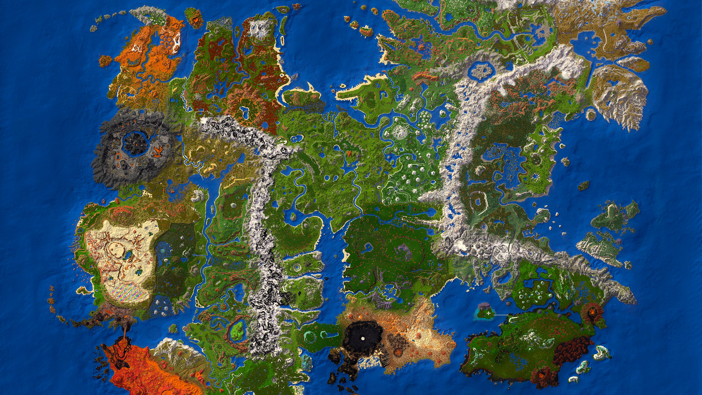
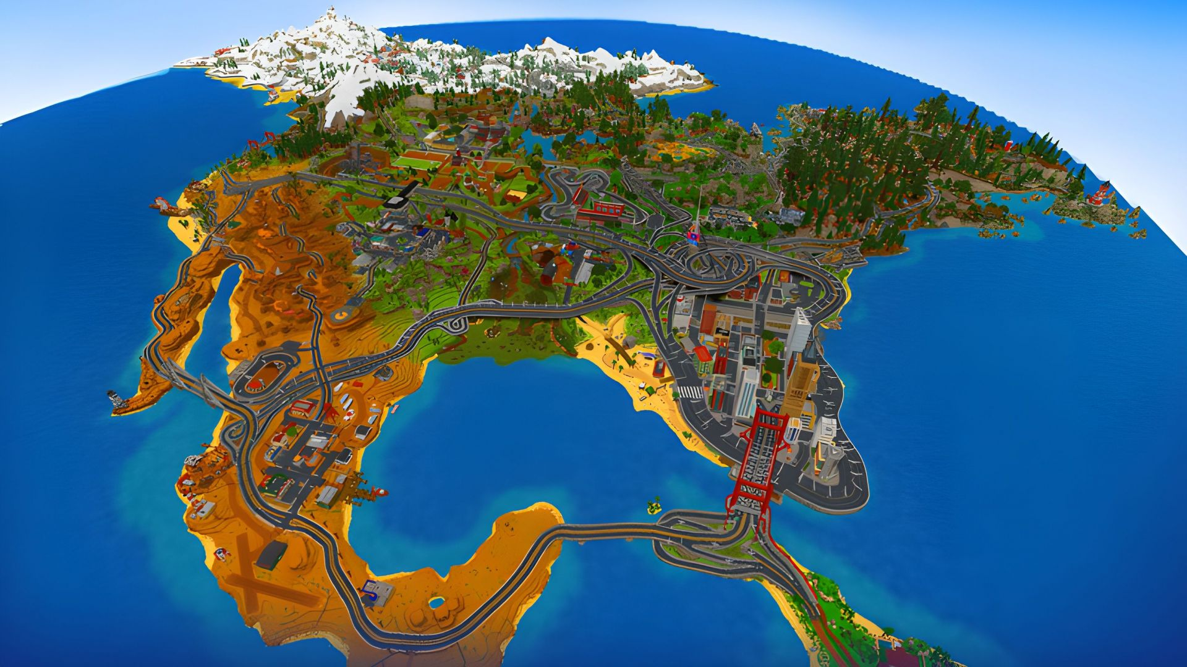
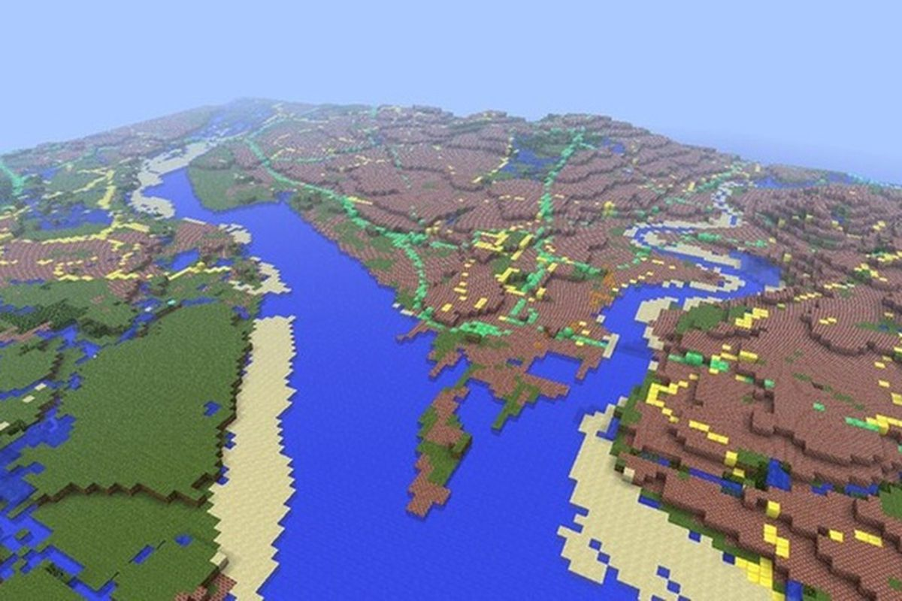

Slide 17

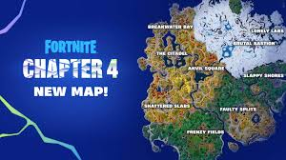

Slide 18

Questions?
Notes:
https://developers.arcgis.com/javascript/index.html

Slide 19

Why JavaScript?
Notes:
https://developers.arcgis.com/javascript/index.html

Slide 20
Why JavaScript?
Diplomatic language of the Internet
Browser and platform agnostic
REST
Notes:
https://developers.arcgis.com/javascript/index.html

Slide 21

map
Notes:
https://developers.arcgis.com/javascript/index.html

Slide 22

map
view
Notes:
https://developers.arcgis.com/javascript/index.html

Slide 23
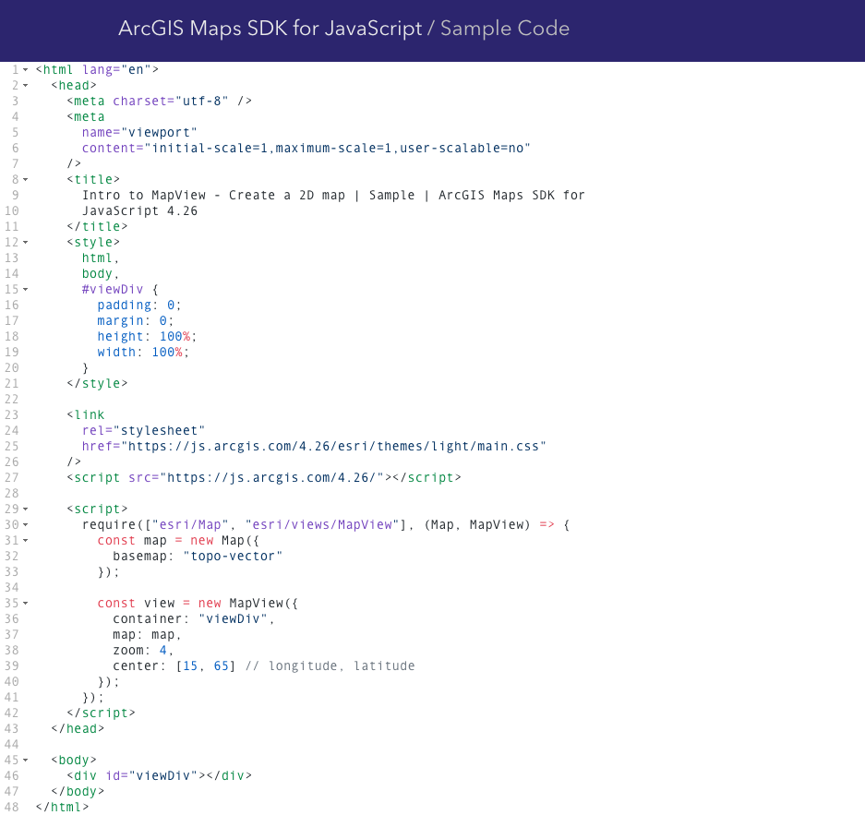
Notes:
https://developers.arcgis.com/javascript/index.html

Slide 24
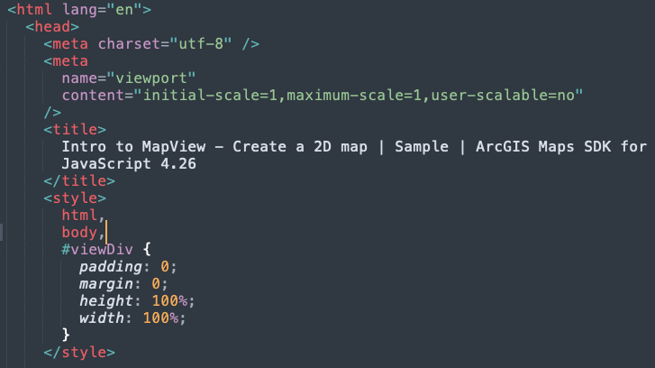
Notes:
https://developers.arcgis.com/javascript/index.html

Slide 25
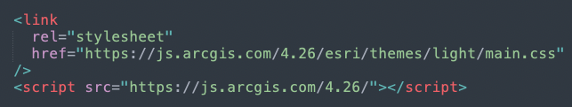
Notes:
https://developers.arcgis.com/javascript/index.html

Slide 26
Notes:
https://developers.arcgis.com/javascript/index.html

Slide 27
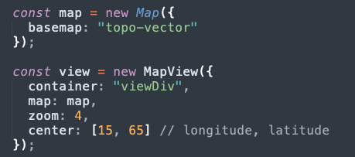
Notes:
https://developers.arcgis.com/javascript/index.html

Slide 28
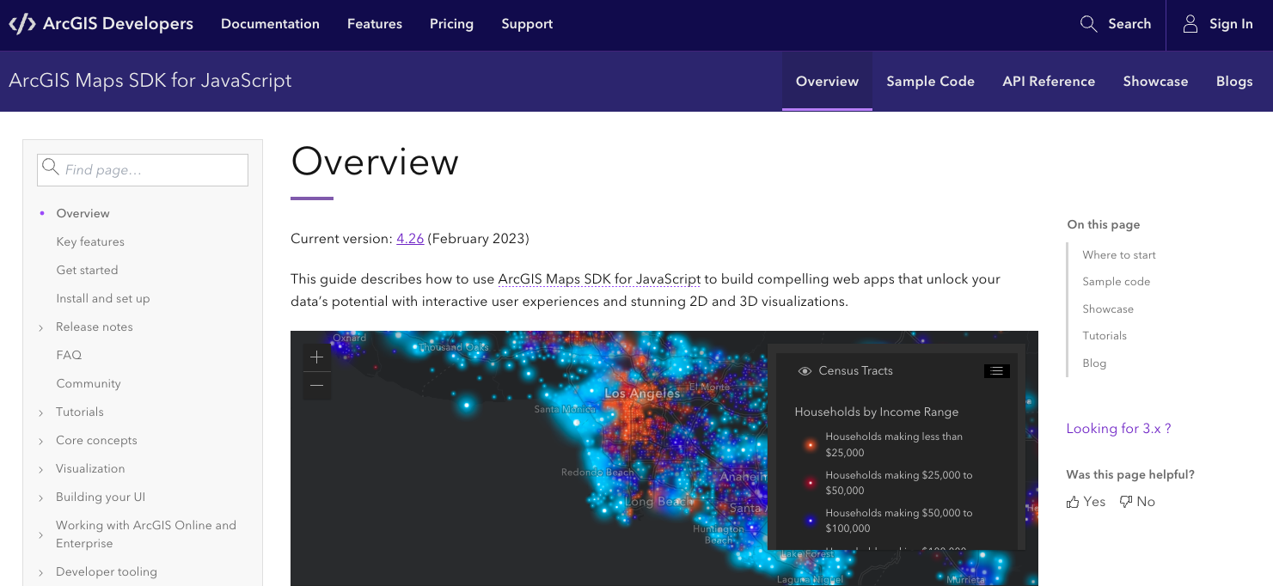
https://developers.arcgis.com/javascript
Notes:
https://developers.arcgis.com/javascript/index.html

Slide 29
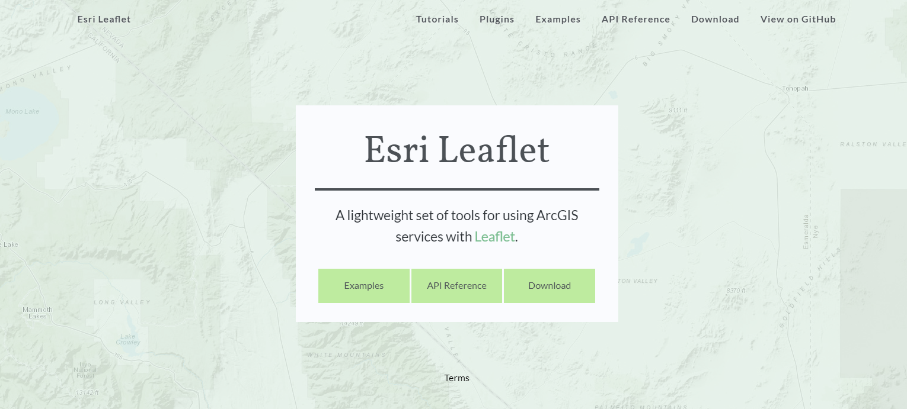
Notes:
http://esri.github.io/esri-leaflet/

Slide 30

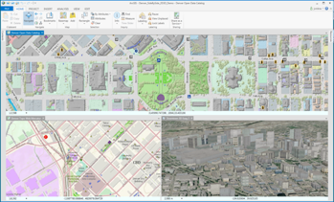
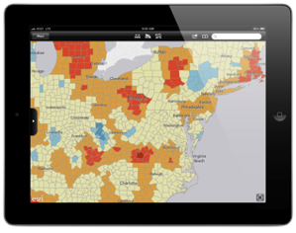
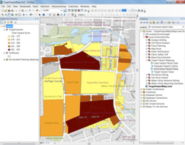
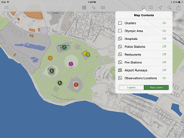
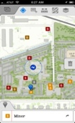
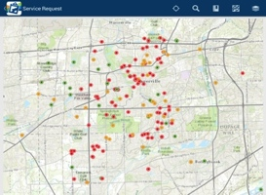


The ArcGIS Platform
ArcGIS Desktop
Apps
APIs & SDKs
http://
http://
http://
Maps
Scenes
ArcGIS Enterprise
(ArcGIS Server +
Portal for ArcGIS)
ArcGIS Online
Analytics
Feature
Layers
Scene Layers
Tile
Layers
Image
Layers
Analytics
Services
Data
Notes:
The ArcGIS Platform
All of this data is exposed through the geoinformation model as items that users and apps can work with.
These items are delivered by ArcGIS Online or ArcGIS Server.
Both have a portal that make these information items available to users.
The Apps, Desktop, APIs, and SDKs are all powered by this information.
All of this rests on a bed of services and data. The apps and users interact directly with the information from these services.
Today, we are focusing on the APIs & SDKs, specifically, the ArcGIS Runtime SDK for .NET.

Slide 31
Career Opportunities

Slide 32

https://www.esri.com/en-us/about/careers/student-jobs
Notes:
https://www.esri.com/en-us/about/careers/student-jobs

Slide 33





Notes:
http://www.esri.com/events/user-conference

Slide 34


Geomentoring
Notes:
http://www.esri.com/careers/main/student-jobs

Slide 35


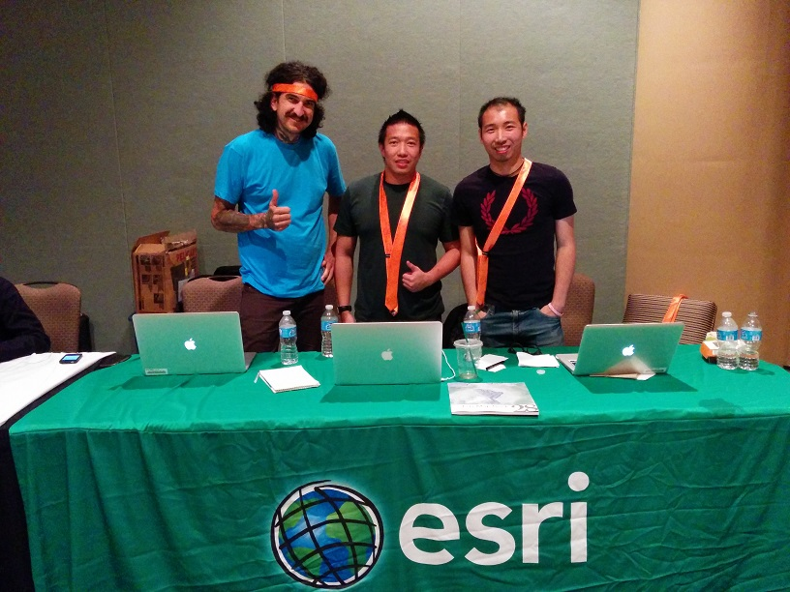
Hackathons
Notes:
Hackathons

Slide 36
Unsolicited Advice
Notes:
You didn’t ask, but…

Slide 37


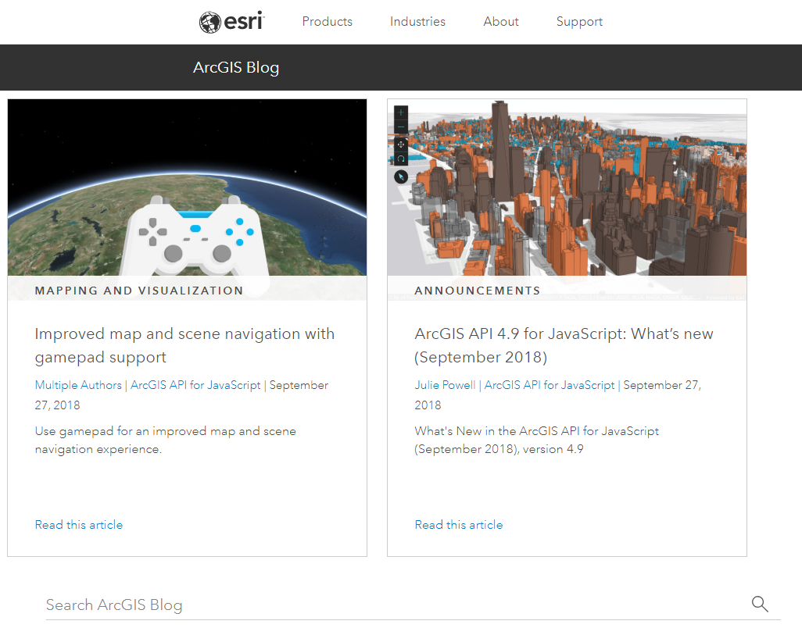
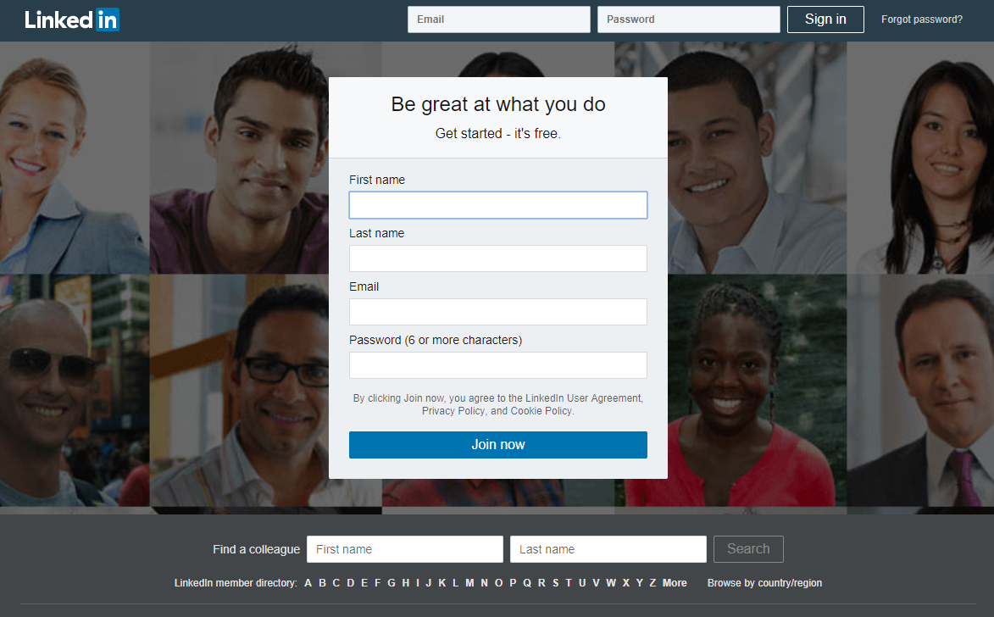

Slide 38
Thank you! Questions?
Web Map Development Prairieview Discovery Day
@noashx
nsager@esri.com

